Slide 1






Customer Analysis Report & Engagement (CARE) Summaries
J31CB Customer Analytics
1
Notes:
This presentation is meant for CIC-focused customers to define the products that the J31CB Analytics Team can produce and how they can be easily understood by customers and customer representatives.

Slide 2
Customer Analysis Report & Engagement (CARE) Summaries
DLA Mission Alignment: Our DLA Customer Analysis Report Engagement Summary (CARES) related reports promote efficiency in DLA’s customer facing processes by providing actionable information in a variety of formats.

Slide 3
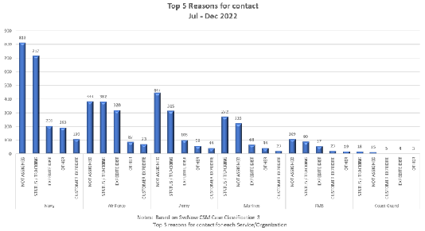






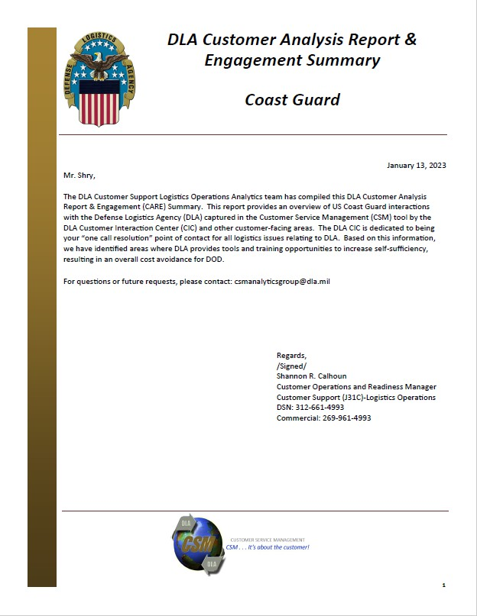
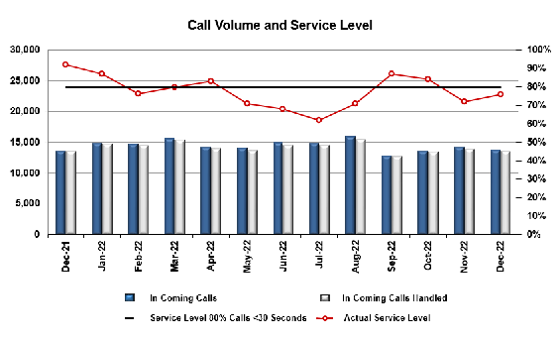



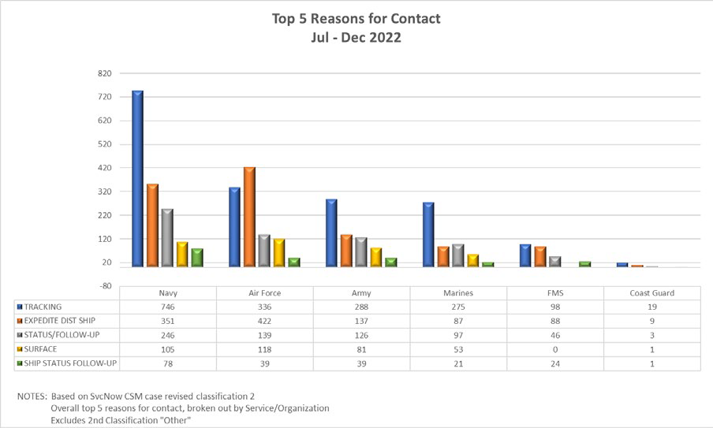
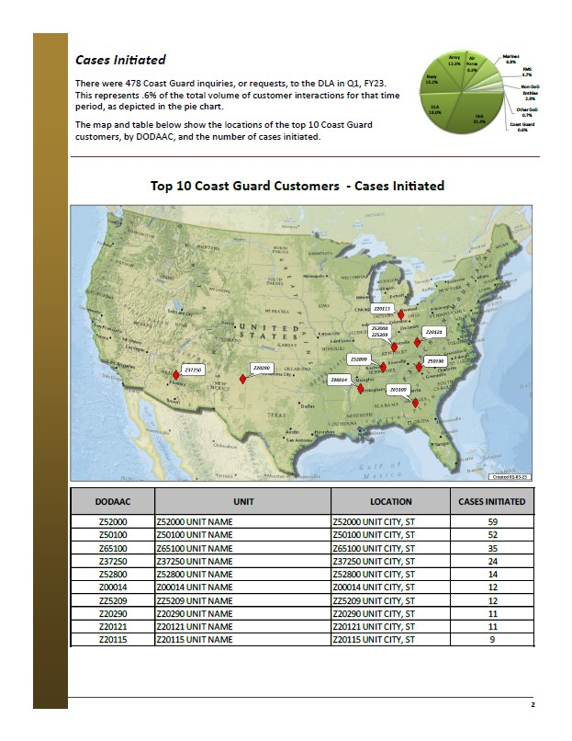








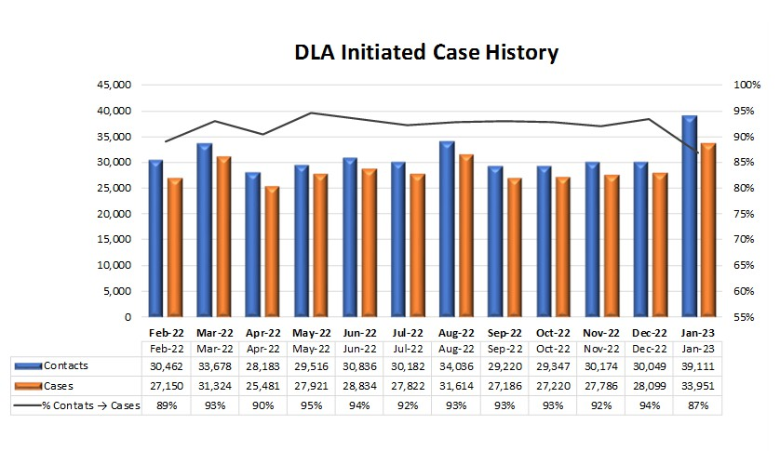


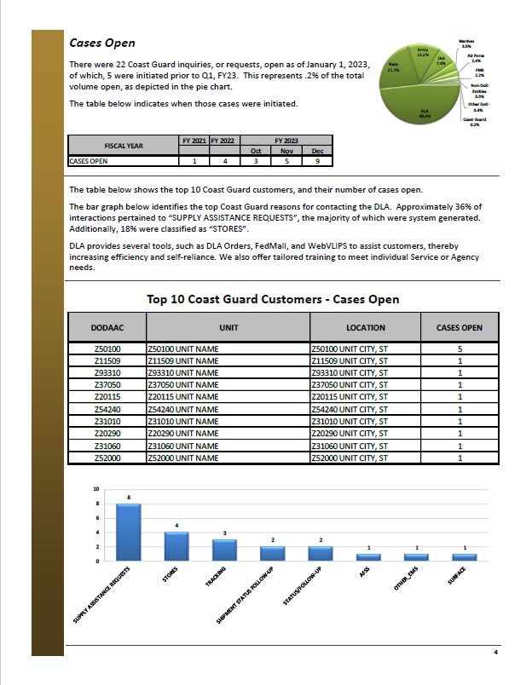
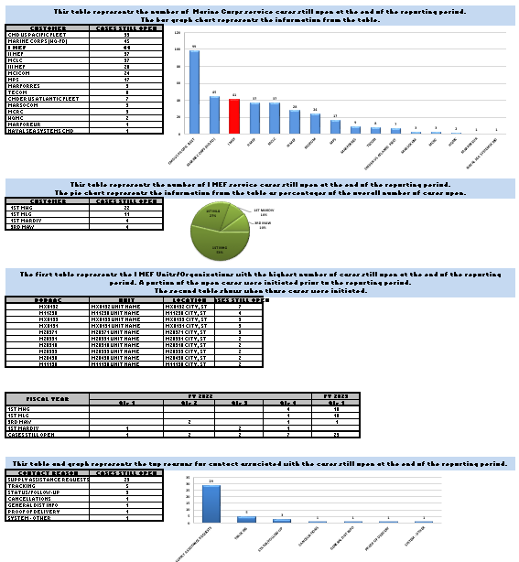
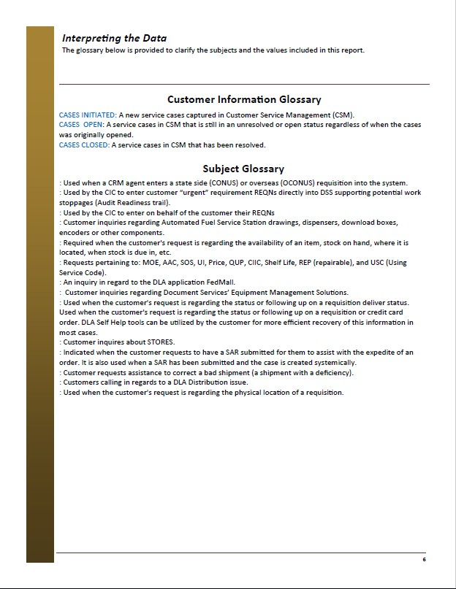
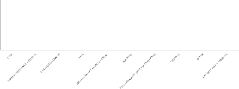



Customer Analysis Report & Engagement (CARE) Summaries
PPTs
PDFs
SPREADSHEETS
This table represents the number of new service cases initiated, by Agency, during the reporting period.
The pie chart represents the information from the table as percentages of the overall number of cases initiated.
UNKNOWN (Unk) represents service tickets where the DODAAC was either not known, or where one was not provided, at the time the ticket was created.
Unk
CUSTOMER
CASES INITIATED
161
DLA
Air Force 6.7%
Army
119
9.4% ^{Other}
DLA
38
DoD
Navy 4.7%
Other DoD
36
Army 29.3%
8.9%
Non-DoD Entities 1.0%
Air Force
27
Navy
19
Non-DoD Entities
4
Marines 0.2%
Marines
1
Coast Guard
1
Unk 39.7%
Coast Guard 0.2%
This table represents the Units/Commands with the highest number of cases initiated during the reporting period.
DODAAC UNIT
H92224 H92224 UNIT NAME
LOCATION
H92224 CITY, ST
CASES INITIATED
33
W34XYK W34XYK UNIT NAME
W34XC5 W34XC5 UNIT NAME
W50YER W50YER UNIT NAME
Q99130 Q99130 UNIT NAME
W34GMT W34GMT UNIT NAME
FB6161 FB6161 UNIT NAME
FB6423 FB6423 UNIT NAME
SE5F2T SE5F2T UNIT NAME
SE5F2T SE5F2T UNIT NAME
W34XYK CITY, ST
19
W34XC5 CITY, ST
14
W50YER CITY, ST
12
Q99130 CITY, ST
10
W34GMT CITY, ST
9
FB6161 CITY, ST
9
FB6423 CITY, ST
8
SE5F2T CITY, ST
8
This table and graph repres
SE5F2T CITY, ST
8
CAGE
CONTACT REASON
CASES INITIATED
ents the top reasons for contact associated with the cases initiated during the reporting period.
160
140 ¹³⁴
120
100 ⁹²
80
60
⁴⁰ 24
²⁰ ¹³ ¹² ¹¹ ⁸ ⁸ ⁸ 6
0
top national stock numbers associated with the actions initiated during the reporting period.
END ITEM WEAPON SYSTEM ACTIONS INITIATED
N/A SEAL,GUN,PORTWEAPON SYSTEM 5
N/A WINDSHIELD PANEL,AIRCRAFTWEAPON SYSTEM 5
N/A SHELTER,FIRE,M-2002WEAPON SYSTEM 4
N/A ANGLE,STRUCTURALWEAPON SYSTEM 4
N/A TAG,ELECTRONIC IDENTIFICATIONWEAPON SYSTEM 4 TRAT N/A SOLUTION,PRESERVATION,CONCENTRATWEAPON SYSTEM 3 E N/A CYLINDER ASSEMBLY,ACTUATING,LINEWEAPON SYSTEM 3
N/A BEAM,STRUCTURALWEAPON SYSTEM 3
N/A CIRCUIT CARD ASSEMBLYWEAPON SYSTEM 3
N/A ISOPROPYL ALCOHOLWEAPON SYSTEM 3
hen DODAAC, for the individuals who requested assistance for those cases initiated during the reporting period. It also provides the reason for contact, email and phones numbers when available.
SUPPLY ASSISTANCE REQUESTS
134
STATUS/FOLLOW-UP
92
EPOS
24
A0E/A05 EXCEPT REQN DSS ENTRY
13
TRACKING
12
FUELSMANAGER DEFENSE ENTERPRISE
11
FEDMALL
8
OTHER
8
EXPEDITE DIST SHIPMENTS
8
6
NSN
This table represents the
5330001867745
SEAL,GUN,PORT
ITEM NAME
1560014864893
WINDSHIELD PANEL,AIRCRAFT
4240014983194
SHELTER,FIRE,M-2002
9540000279172
ANGLE,STRUCTURAL
6350015793126
TAG,ELECTRONIC IDENTIFICATION
6850013266528
SOLUTION,PRESERVATION,CONCEN
3040016651836
CYLINDER ASSEMBLY,ACTUATING,LIN
9540005165972
BEAM,STRUCTURAL
5998017058364
CIRCUIT CARD ASSEMBLY
6810013822904
ISOPROPYL ALCOHOL
This table represents the point of contact information, by Command t
METRICS
Notes:
First, these are the products and formats commonly produced by the J31CB Analytics Team – CARES in the form of Spreadsheets and PDFs, PowerPoints containing catered metrics and visualized data, as well as many other formats and products by request.

Slide 4
Customer Analysis Report & Engagement (CARE) Summaries
Customer Service Analytics
Our Analyst will compile information from customer interactions with the DLA Customer Interaction Center (CIC) and other DLA forward facing entities and derive Customer Analysis and Engagement Summaries (CARES) or other specialized reports based on your needs. Here are a few key questions our reports can help to answer:
Who is calling and what are they calling about?
What DLA training could benefit your customers?
How is your organization interacting with DLA?
Is DLA assisting you in resolving your lifecycle logistics concerns?
What does a report do?
Identify key pain-points or areas where Logistics Operations may provide tools and/or training to organizations within DOD.
Improve awareness and increase self-sufficiency, resulting in an overall cost avoidance for DOD.
What is in a report?
Number of interactions within a given timeframe.
Available by DODAAC, COCOM, country, state or individual caller
Easy to read map and graphs
Associated National Stock Numbers
Data Interpretation

Slide 5
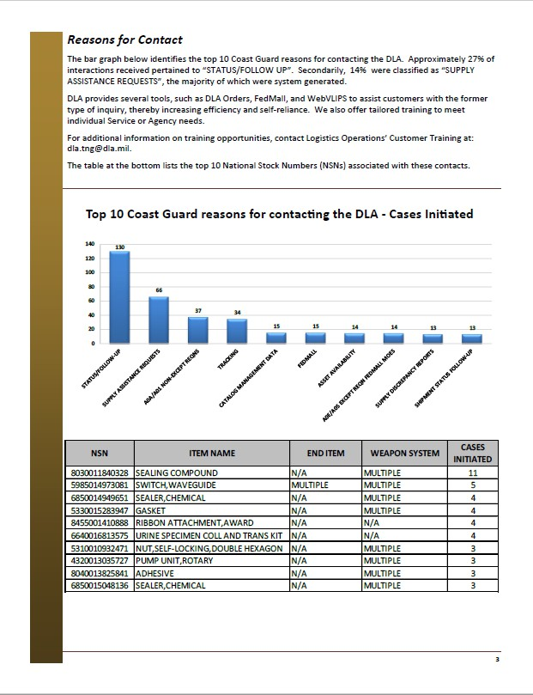
CARE Summaries PDF
Notes:
Looking into CARE Summaries in PDF form, we can identify that the case data is split into three major sections: Cases Initiated, Cases Open, and Cases Closed. These are individually important, and defined here:
-Cases Initiated defines the number of cases that were first opened between the first and last days of the reporting month
-Cases Open defines the number of cases that were still open on the last day or reporting day of the reporting month. These cases could’ve been initiated at any time, or even closed then reopened
-Cases Closed defines the number of cases that were closed between the first and last days of the reporting month
This slide (pages 2 and 3 of any CARES PDF) addresses the Cases Initiated section. Seen above, these pages highlight three major data aspects:
-Top 10 Initiating Customers shows a geographic representation of where the ten most commonly case-initiating DoDAACs are located, along with the relevant number of cases initiated
-Reasons For Contact defines the most common reasons why the noted DoDAACs in the reporting area are creating cases with the DLA CIC (Customer Interaction Center). Common examples of Reasons For Contact include Supply Assistance Requests, Tracking/Tracking Data, Database assistance, and Status/Follow-up checks
-The NSN Table highlights the ten most commonly actioned items across all DoDAACs in a reporting area. This shows an NSN’s Item Name, End Item, Weapon System, and the relevant number of cases initiated against that NSN

Slide 6
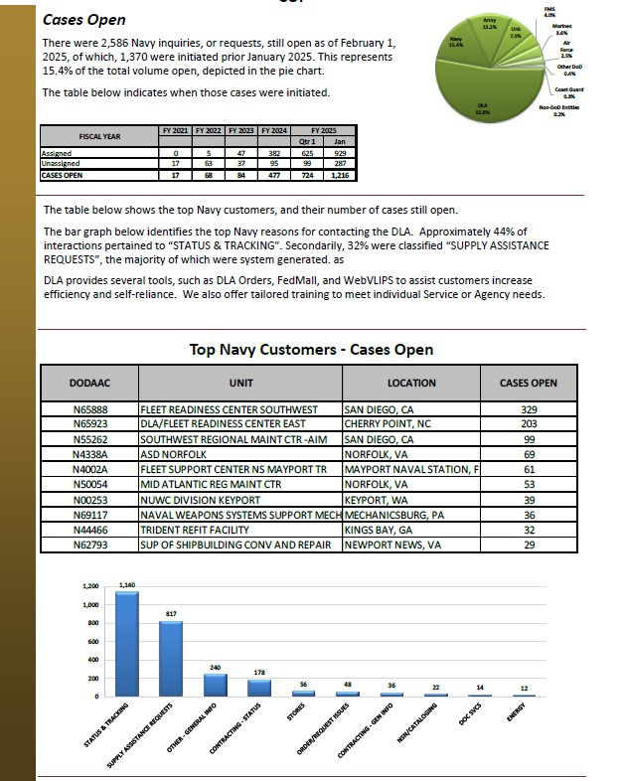
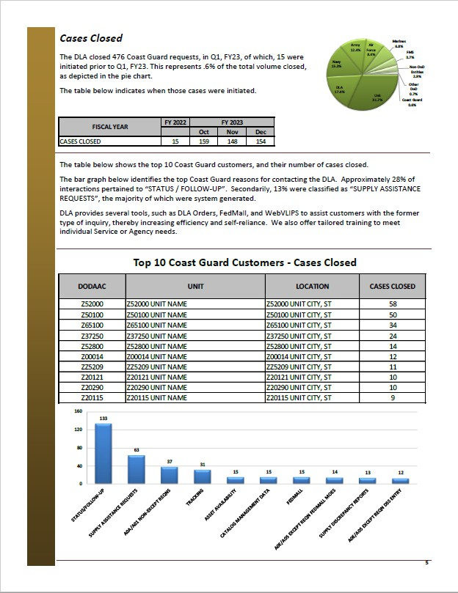
CARE Summaries PDF
Notes:
Next, Cases Open and Cases Closed are shown on pages 4 and 5 of any CARES PDF. Each of these sections highlight three major data points:
-Fiscal Year Table showing the timeline distribution of cases relevant to each section (Open vs Closed cases relevant to the report month)
-Top 10 customers by DoDAAC relating to number of cases Open or Closed
-Reasons For Contact chart displaying the most common reasons why the noted DoDAACs in the reporting area are creating cases with the DLA CIC
CARES PDFs also contain a Data Dictionary following the CIC-based information in each report, used to translate terms for any customer.

Slide 7
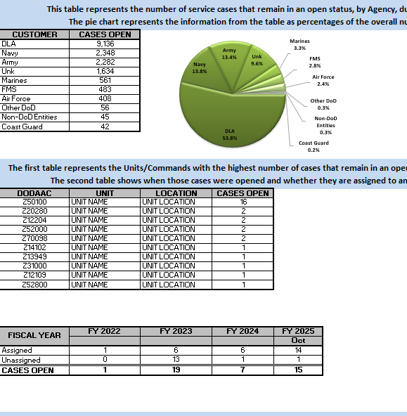













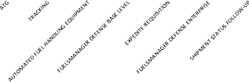
CARE Summaries Std Spreadsheet
This table represents the number of new service cases initiated, by Agency, during the reporting period.
The pie chart represents the information from the table as percentages of the overall number of cases initiated.
Army
CUSTOMER
CASES INITIATED
DLA
410
Air Force 18.8%
Air Force
211
Other DoD 3.2%
Navy
170
DLA 23.3%
Navy 9.1%
82
Other DoD
29
Marines 0.2%
Non-DoD
Marines
2
Non-DoD Entities
1
Army 45.3%
Entities 0.1%
This table represents the Units/Commands with the highest number of cases initiated during the reporting period.
DODAAC | UNIT | LOCATION | CASES INITIATED
WK4GBW | UNIT NAME | WK4GBW CITY, ST | 73
WK4F8Q | UNIT NAME | WK4F8Q CITY, ST | 58
SE6N04 | UNIT NAME | SE6N04 CITY, ST | 52
SE6N03 | UNIT NAME | SE6N03 CITY, ST | 48
W51107 | UNIT NAME | W51107 CITY, ST | 48
W9005D | UNIT NAME | W9005D CITY, ST | 38
N67022 | UNIT NAME | N67022 CITY, ST | 32
FB5587 | UNIT NAME | FB5587 CITY, ST | 31
W81WRE | UNIT NAME | W81WRE CITY, ST | 30
FB5682 | UNIT NAME | FB5682 CITY, ST | 24
CONTACT REASON
This table and graph represents the top reasons for contact associated with the cases initiated during the reporting period.
SUPPLY ASSISTANCE REQUESTS
CASES INITIATED
STATUS/FOLLOW-UP
352
400
ATG
102
350
300
250
200
150
100
50
352
TRACKING
76
AUTOMATED FUEL HANDLING EQUIPMENT
53
FUELSMANAGER DEFENSE BASE LEVEL
51
EXPEDITE REQUISITION
26
FUELSMANAGER DEFENSE ENTERPRISE
22
102
SHIPMENT STATUS FOLLOW-UP
18
76
53
51
SURFACE
16
26
22
18
16
13
13
0
This table represents the top national stock numbers associated with the actions initiated during the reporting period.
NSN | ITEM NAME | END ITEM | WEAPON SYSTEM | ACTIONS INITIATED
2940015450012 | FILTER,FLUID | END ITEMS | SUPPORTED WEAPON SYSTEMS | 9
2815014925709 | PARTS KIT,DIESEL ENGINE | END ITEMS | SUPPORTED WEAPON SYSTEMS | 7
5330012821619 | RUBBER ROUND SECTION | END ITEMS | SUPPORTED WEAPON SYSTEMS | 6
8030009381947 | CORROSION PREVENTIVE COMPOUND | END ITEMS | SUPPORTED WEAPON SYSTEMS | 6
8345000597995 | SLING,FLAGSTAFF | END ITEMS | SUPPORTED WEAPON SYSTEMS | 6
8345002500919 | SLING,FLAGSTAFF | END ITEMS | SUPPORTED WEAPON SYSTEMS | 5
2610015990317 | TIRE,PNEUMATIC,VEHICULAR | END ITEMS | SUPPORTED WEAPON SYSTEMS | 5
8010015737608 | EPOXY PRIMER COATING KIT | END ITEMS | SUPPORTED WEAPON SYSTEMS | 5
2610015330485 | TIRE,PNEUMATIC,VEHICULAR | END ITEMS | SUPPORTED WEAPON SYSTEMS | 5
2530009119427 | BRAKE,E,PANDER SHOE | END ITEMS | SUPPORTED WEAPON SYSTEMS | 4
This table represents the point of contact information, by Command then DODAAC, for the individuals who requested assistance for those cases initiated during the reporting period.
It also provides the reason for contact, email and phones numbers when available.
Notes:
Transitioning into Excel Spreadsheet-based CARE Summaries, we find very similar representations of the same three major sections of data (Cases Initiated, Open, Closed), this time expressed in slightly different ways. In addition to the data points noted on slides 5 and 6 (PDF Pages 2-5), the standard CARES spreadsheets also contact a Point of Contact (POC) table at the very bottom of each sheet. This table shows the primary POC for each relevant DoDAAC, their contact information, and the number of cases initiated or actionable requests submitted by that individual.

Slide 8
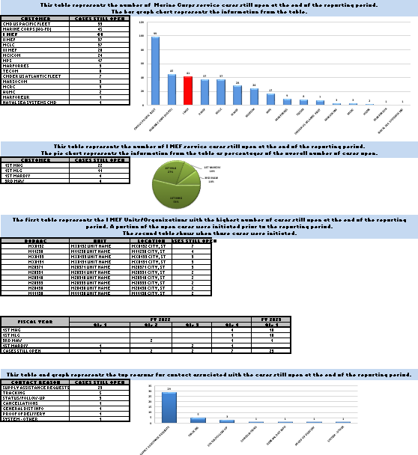











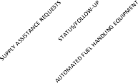
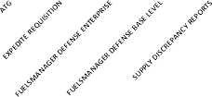
CARE Summaries Std and Non-Std Spreadsheet
This table represents the number of cases closed, for each Agency, during the reporting period.
The pie chart represents the information from the table as percentages of the overall number of cases closed.
NOTE: A portion of the cases closed were opened prior to the reporting period.
Army
CUSTOMER
CASES CLOSED
Air Force
413
DLA 18.0%
DLA
159
Other
Navy
151
Air Force 19.0%
Navy 10.0%
DoD 3.2%
Other DoD
84
Marines
27
Marines 0.2%
Non-DoD Entities
2
1
Non-DoD
Army 49.3%
Entities 0.1%
The first table represents the Units/Commands with the highest number of cases closed during the reporting period.
The second table shows when those cases were initiated
DODAAC | UNIT | LOCATION | CASES CLOSED
WK4GBW | UNIT NAME | WK4GBW CITY, ST | 70
SE6N04 | UNIT NAME | SE6N04 CITY, ST | 52
WK4F8Q | UNIT NAME | WK4F8Q CITY, ST | 16
W51107 | UNIT NAME | W51107 CITY, ST | 49
N67022 | UNIT NAME | N67022 CITY, ST | 35
W9005D | UNIT NAME | W9005D CITY, ST | 35
FB5587 | UNIT NAME | FB5587 CITY, ST | 30
W58MKR | UNIT NAME | W58MKR CITY, ST | 29
FB5612 | UNIT NAME | FB5612 CITY, ST | 23
W81WRE | UNIT NAME | W81WRE CITY, ST | 22
FY 2022
FY 2023
FISCAL YEAR |  | Qtr 1 | Jan
CASES CLOSED | 24 | 122 | 691
This table and graph represents the top reasons for contact associated with the cases closed during the reporting period.
CONTACT REASON | CASES CLOSED
SUPPLY ASSISTANCE REQUESTS | 341
STATUS/FOLLOW-UP | 103 | 400
AUTOMATED FUEL HANDLING EQUIPMENT | 50 | 350
TRACKING | 49 | 300
ATG | 28 | 250
EXPEDITE REQUISITION | 24 | 200
FUELSMANAGER DEFENSE ENTERPRISE | 19 | 150
FUELSMANAGER DEFENSE BASE LEVEL | 15 | 100
341
103
SUPPLY DISCREPANCY REPORTS | 13 | 50 | 50 49 28 | 24 | 19 | 15 | 13 | 13
SURFACE | 13 | 0
This table represents the point of contact information, by DODAAC, for the individuals who requested assistance for those cases closed during the reporting period.
It also provides the reason for contact, email and phones numbers when available.
Notes:
The screenshot on the left is the Cases Closed continuation from the last slide. The screenshot on the right is an example of a slightly customer-catered “Non-Standard” CARE Summary. Non-Standard CARES can feature any number of edits or changes to the typical CARES, such as highlights on specific DoDAACs, areas, trends, or customer-defined metrics.

Slide 9







CARE Summaries Non-Std Spreadsheet
DODAAC | UNIT | LOCATION | CASES INITIATED
FB3034 | UNIT | FB3034 CITY, ST | 36
FB4801 | 49 LRS LGRDDR | FB4801 CITY, ST | 34
FB4460 | 19 LRS LGRDDC | FB4460 CITY, ST | 27
FB2823 | 96 LRS LGRDDC | FB2823 CITY, ST | 24
FB3089 | 502 LRS RND JBSA LGRDDC | FB3089 CITY, ST | 23
FB4469 | 377 LRS LGRDDC | FB4469 CITY, ST | 21
FB4419 | 97 LRS LGRD | FB4419 CITY, ST | 16
FB3047 | 502 LRS LGRDDC | FB3047 CITY, ST | 14
FB4620 | 92 LRS LGRDDC | FB4620 CITY, ST | 12
FB3020 | 82 LRS LGRTDDC | FB3020 CITY, ST | 10
FB3029 | 71 ISS LGS | FB3029 CITY, ST | 9
FB3099 | 47 LRF LGS | FB3099 CITY, ST | 9
FB4887 | 56 LRS SCM | FB4887 CITY, ST | 7
FB3022 | 14 LRS | FB3022 CITY, ST | 7
FB4888 | 56 LRS RNI | FB4888 CITY, ST | 3
FB3010 | 81 SUPS LGS | FB3010 CITY, ST | 3
FB3300 | 42 LRS LGRM | FB3300 CITY, ST | 1
CONTACT REASON | CASES INITIATED | PERCENTAGE OF TOTAL VOLUME OF INTERACTIONS
REQUISITION | 220 | 85.94%
MISSION ISS - MRO | 12 | 4.69%
NSN/CATALOGING | 10 | 3.91%
SYSTEM | 6 | 2.34%
OTHER | 3 | 1.17%
ENERGY PRODUCTS AND SERVICES | 2 | 0.78%
VENDOR ASSISTANCE | 1 | 0.39%
J67 EMS | 1 | 0.39%
DLA DISP SVCS | 1 | 0.39%
NSN | ITEM NAME | END ITEM | WEAPON SYSTEM | ACTIONS INITIATED
5365013581820 | ITEM NAME | END ITEM | WEAPON SYSTEM | 7
6135014475082 | ITEM NAME | END ITEM | WEAPON SYSTEM | 6
1615007014142 | ITEM NAME | END ITEM | WEAPON SYSTEM | 5
6220009322500 | ITEM NAME | END ITEM | WEAPON SYSTEM | 5
1680014405106 | ITEM NAME | END ITEM | WEAPON SYSTEM | 4
5930007739996 | ITEM NAME | END ITEM | WEAPON SYSTEM | 4
1620007942624 | ITEM NAME | END ITEM | WEAPON SYSTEM | 4
1680015814331 | ITEM NAME | END ITEM | WEAPON SYSTEM | 4
1680000151693 | ITEM NAME | END ITEM | WEAPON SYSTEM | 3
5930005484267 | ITEM NAME | END ITEM | WEAPON SYSTEM | 3
FB2823
CONTACT REASON |  | CASES INITIATED
STATUS/FOLLOW-UP |  | 11
SUPPLY ASSISTANCE REQUESTS |  | 9
DISP SVCS RTD WEB |  | 3
SS&D PROTECTED STOCK LEVEL |  | 3
TRACKING |  | 2
EXPEDITE REQUISITION |  | 1
12 11
9
9
6
3 | 3 | 3 |  | 2 | 1
0
NSN |  | ITEM NAME |  |  | ACTIONS INITIATED
5995013099969 |  | CABLE ASSEMBLY,RADIO FREQUENCY |  |  | 3
2320013808604 |  | TRUCK,UTILITY |  |  | 2
9150013062470 |  | FLUID,COOLANT |  |  | 2
5945014233669 |  | RELAY,ELECTROMAGNETIC |  |  | 2
2320013469317 |  | TRUCK,UTILITY |  |  | 2
6220013098384 |  | LIGHT,TAXIING,AIRCRAFT |  |  | 2
6130013087643 |  | POWER SUPPLY |  |  | 2
6740003894813 |  | BAR AND MASK ASSEMBLY,PLAIN,REAR |  |  | 2
8030010979102 |  | SEALING COMPOUND |  |  | 1
6625010322524 |  | VOLTMETER |  |  | 1
CLASS 1/CLASS 2/CLASS 3 |  | CASES INITIATED
REQUISITION |  |  | 26
STATUS/FOLLOW-UP |  |  | 11
CUSTOMER DIRECT |  |  | 1
MISSION (OPEN MRO/HUNG BA) |  |  | 1
NOT ASSIGNED |  |  | 4
OTHER |  |  | 5
SUPPLY ASSISTANCE REQUESTS |  |  | 9
NOT ASSIGNED |  |  | 4
OTHER |  |  | 5
SS&D PROTECTED STOCK LEVEL |  |  | 3
APPROVE |  |  | 2
NOT APPLICABLE |  |  | 1
TRACKING |  |  | 2
NOT ASSIGNED |  |  | 2
EXPEDITE REQUISITION |  |  | 1
OTHER |  |  | 1
SYSTEM |  |  | 3
DISP SVCS RTD WEB |  |  | 3
APPLICATION ACCESS |  |  | 2
APPLICATION SUPPORT |  |  | 1
POC/CONTACT REASON CLASS 2 |  | CASES INITIATED
Notes:
Examples of Non-Standard CARES additions, continued.

Slide 10
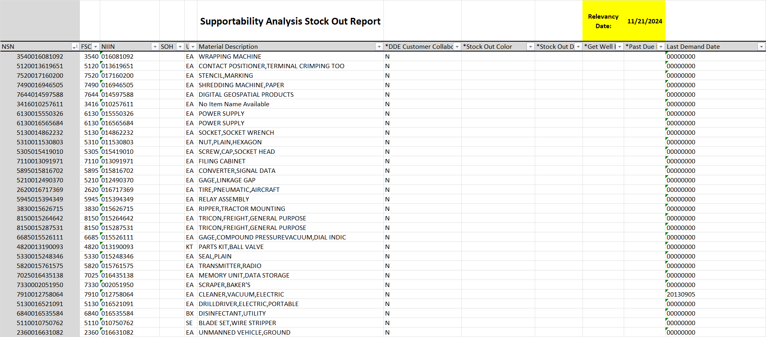
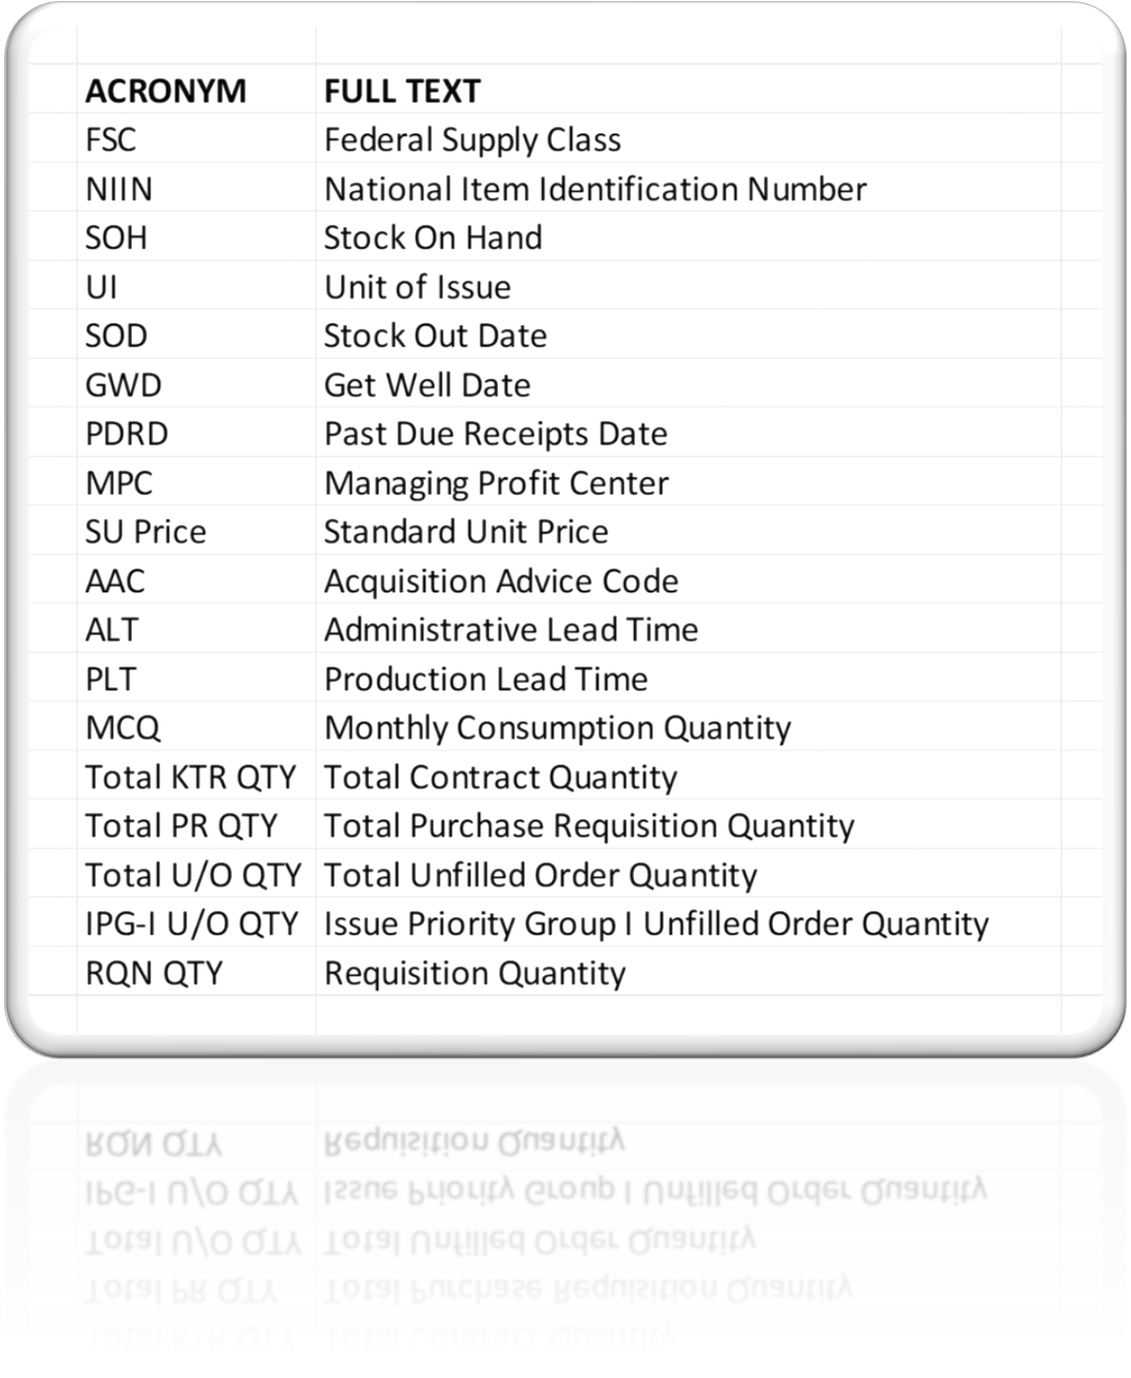
Supportability Analysis Stock Out Report Sheet
Implementation date: 01 March 2025
Featuring:
PEOPLE
PRECISION
POSTURE
PARTNERSHIPS
WARFIGHTER ALWAYS
14
Notes:
Supportability Analysis Stock Out Report Sheet (SA-SOR) information is a recent addition to our CARE Summaries, this separate sheet features investigative information on each of the NSNs relevant to any CARE Summary. The above “Featuring” box notes each of the data points noted per NSN in each report.

Slide 11

Customer Analytics Metrics
Open Cases by MSC
As of: 01 February 2025
100,000
10,000
1,000
100
10
1
6,677
5,673
1,847
934
903
665
30
30
20
 | AV | L&M | EN | DIST | HQ | TS | DS | CIC L1 | CIC L2
Open Unassigned >30 Days | 1,329 | 37 | 214 | 3 | 415 | 152 | 17 | 1 | 0
Open Unassigned >5 Days | 1,615 | 51 | 231 | 8 | 422 | 208 | 20 | 3 | 0
Open Unassigned | 1,821 | 128 | 275 | 279 | 462 | 246 | 27 | 5 | 5
Total Open | 6,677 | 5,673 | 1,847 | 934 | 903 | 665 | 30 | 30 | 20
Source: SvcNow Data
As of: February 1, 2025 0400
12
PEOPLE
PRECISION
POSTURE
PARTNERSHIPS
WARFIGHTER ALWAYS
Notes:
The Analytics Team also caters metrics to any specific situation required by a customer. These slides 11 and 12 show two options for demonstrating trends over time for each of our Major Subordinate Command or program office-based customers. Metrics are not limited to this data, nor this format.

Slide 12

Customer Analytics Metrics
Cases Closed by MSC January 2024 Through January 2025
100,000
10,000
1,000
100
10
1
Cases Closed
Jan-24
Feb-24
Mar-24
Apr-24
May-24
Jun-24
Jul-24
Aug-24
Sep-24
Oct-24
Nov-24
Dec-24
Jan-25
CIC L1
15,541
16,208
16,948
16,133
14,569
12,712
14,009
15,393
14,121
14,278
12,240
11,119
12,490
AV
6,363
6,398
5,637
6,093
6,342
5,370
6,716
6,354
6,222
7,010
5,594
5,809
5,867
L&M
4,514
3,829
4,053
4,122
3,742
3,960
4,312
4,659
4,087
5,127
3,984
3,520
3,764
DIST
1,980
2,154
2,597
2,831
2,506
2,095
2,889
3,167
2,989
3,027
2,453
2,436
2,688
EN
1,928
2,055
2,386
2,655
2,831
2,367
2,660
2,278
2,523
2,285
1,905
1,908
2,063
HQ
3,448
3,766
3,770
3,681
2,665
1,919
2,163
2,168
1,726
1,919
1,421
1,432
1,467
TS
960
1,188
1,180
1,196
1,156
1,031
1,109
1,138
1,169
1,145
766
815
832
CIC L2
450
582
600
531
408
329
349
463
338
348
320
285
320
DS
106
118
105
101
80
66
68
82
66
79
79
56
67
Source: SvcNow Data
As of: February 1, 2025 0400
13
PEOPLE
PRECISION
POSTURE
PARTNERSHIPS
WARFIGHTER ALWAYS
Notes:
Metrics continued.

Slide 13

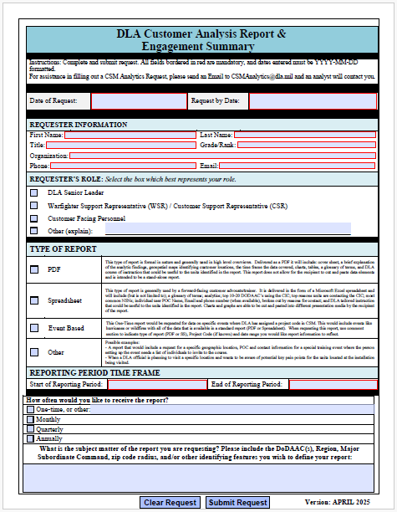
Customer Analysis Report & Engagement (CARE) Request Form
How to request a report?
Email us at csmanalytics@dla.mil and an analyst will be happy to assist you.
PEOPLE
PRECISION
POSTURE
PARTNERSHIPS
WARFIGHTER ALWAYS
15
Notes:
Reports are generally requested through the Customer Engagement webpage at: https://www.dla.mil/Customer-Support/Communications/
Any questions or requests should be routed to the Analytics Team email noted above.

Slide 14


PEOPLE
PRECISION
POSTURE
PARTNERSHIPS
WARFIGHTER ALWAYS
161116
Notes:
Thank you!

